Slide 1
IoT Honeynet Deployment Experience in LAC
Nov 2021

Slide 2
FRIDA, CSIRT CEDIA, ShadowServer
Internet Stability and Security:
Deploy an IoT honeypot network in Latin America and the Caribbean
FRIDA Grants
CEDIA & The Shadowserver foundation initiative to deploy an IoT networks in the region.
Notes:
In late 2020 we applied for and were granted funds by FRIDA project in order to deploy an IoT network in Latin America and the Caribbean.
This is a joint initiative by CEDIA and The Shadowserver Foundation that deployed a large-scale honeypot sensor network in Latin America and the Caribbean, we used the technology developed by Shadowserver for automating honeypot deployments and CEDIA’s CSIRT expertise and contacts in the region.
The data produced is being shared with 21 national CSIRTs and 235 network owners in the region, as well as with a total 109 national CSIRTs and 5,000+ network

Slide 3
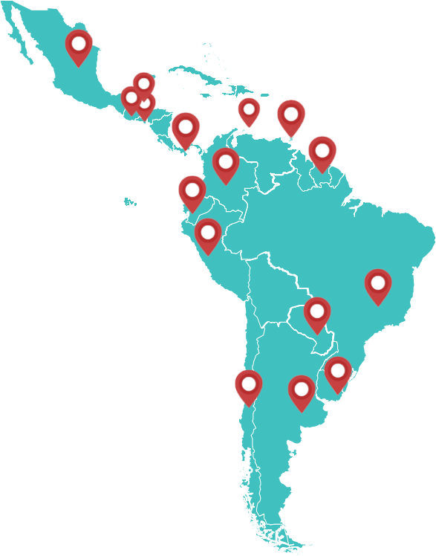
IoT Honeypot Deployment in Latin America and the Caribbean
Financed by LACNIC FRIDA Program
Aim to deploy:
🠆 50 sensors
🠆 15 countries
Achieved ATM*
🠆 ~46 sensors
🠆 20 countries
* @2021-11-01 .
Notes:
This project have been financed by FRIDA Program, the aim is to deploy at least 50 sensors in at least 15 countries in the region.
What happens is that in the LAC region shadowserver had a lack of honeypots to collect data from, we were hosting a couple, and some more in Brazil and Chile as I recall. So info from attacks to networks in LAC was very scarce
At the moment we have implemented 46 sensors in 20 countries. BTW one of these sensors is active with the help of MoRENet, the NREN of mozambique to implement a sensor and, although not in the LAC region we are very proud to have achieved it!

Slide 4
Extending the network to Africa
We are very interested in extending this initiative to interested parties in Africa:
ISP
NREN
Universities
Security companies
etc
In the following slides we will talk about what we
achieved and how can we collaborate with you.

Slide 5
Objectives
To gather information on attempted attacks on computers in our region (from within and outside the region)
To provide organizations with useful information about attacks to/from their networks.
Generate visibility of the region's own activity
Integrate different organizations and teams in a network with common objectives and benefits
Notes:
To gather information on attempted attacks on computers in our region (from within and outside the region)
To provide participant organizations with useful information about attacks to/from their networks.
To improve shadowserver collection of data based on the activity of these sensors.
Generate visibility of the region's own (internal) activity
Integrate different organizations and teams in a network with common objectives and benefits

Slide 6
Benefits
Easy to implement and minimal resources needs.
Information on unusual activity against sensors, like:
IPv4, date, ports, protocols and associated IoCs.
For the contributors to the project we send them the
(full-raw) information regarding their activity against any
sensor in the network.
Visibility and useful data for generating reports
and statistics.
Notes:
honeypots are easy to implement and minimal resources are needed.
We (participants, CEDIA and shadowserver) obtain Information on unusual activity against sensors, like: IPv4, date, ports, protocols and associated IoCs.
For the contributors to the project we send them the (full-raw) information regarding their activity against any sensor in the network.
It helps with a bit more visibility and also useful data for generating reports and statistics.

Slide 7
Is it difficult is to implement a sensor?
Quite easy to implement
Simple requirements:
VMWare, KVM or Xen VM
Ubuntu [18|20].04
1 vCPU
1GB RAM
10-20GB HD
2 public IPv4 (recommended: 4 public IPv4)
Unfiltered & all of them configured in a single NIC
We do not require:
Higher uptime levels
Too much support time
Notes:
Quite easy to implement, in fact the hardware requirements are quite simple
The virtualization host must be: VMWare, KVM, HyperV or Xen
VM running Ubuntu [18|20].04
1 vCPU
1GB RAM
10-20GB HD
2 public IPv4 (recommended: 4 public IPv4)
Unfiltered & all of them configured in a single NIC
We do not require:
Higher uptime levels
Too much support time
Regarding the public IPv4, on each IPv4 a different honeypot is installed, so, the more IPv4 we get, the more data we can collect.
There is a small set of honeypots to install: agnus, heralding, cowrie, dionaea, glastopf, conpot, elasticpot.

Slide 8
Results
Reports from ShadowServer includes data from HP
Real Time visibility of the IoC’s
Important steps toward integrating cybersecurity actors in the region in working groups with common interests
Huge collection of data with a wide variety of collected fields
Several research projects and thesis being worked on
Stats, IoC, reports
Working on project's self-sustain
Notes:
Data extracted from the HP is being used in the reports ShadowServer send to it’s users
Right now we have Real Time visibility of where the attacks are coming from, the IoC’s, etc
We have made important steps toward integrating cybersecurity actors in the region in working groups with common interests, we have dictated several workshops related to how to implement and extract data from a honeypot in LACNIC, REUNA, CUDI, BSidesEcuador
We have a huge collection of data with a wide variety of collected fields
Several research projects and thesis being worked on
We are generating Stats, learning from the IoC, generating reports
Working on project's self-sustain
oh, one more: we learn that, sometimes (many times) cybersecurity companies and ISP simply do not see the benefits of collaboration and community work, we even got somebody says that by helping us we will become their direct competitors in his country (I don't know why)

Slide 9
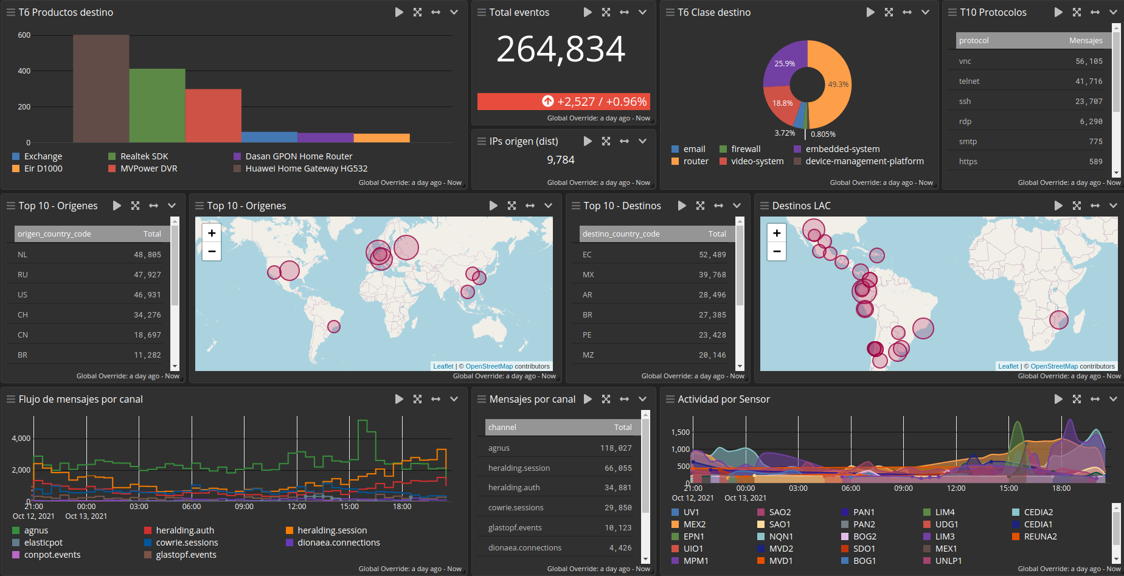
Real time visibility

Slide 10
Interested parties
CERTs/CSIRTs working in the project
UNLP, EPN, CSIRT-NQN
MoRENet
REUNA
CUDI (MX role)
CSIRT-RD
Other institutions and individuals
IXP
Cybersec companies
Gov
HEI
*Enthusiasm skyrocket when they start receiving their data
Notes:
CERTs/CSIRTs working in the project
HEI: UNLP, EPN, CSIRT-NQN
MoRENet, REUNA, CUDI (MX role) - In fact we are starting a regional initiative with several NREN and HEI in order to increase the deployment of honeypots around the region.
In fact all the HP issue has an interesting side: it helps HEI and NREN and others to have a common objective, to gather around something to start collaborating and talking to each other.
Other institutions and individuals
IXP
Cybersec companies
Gov (CSIRT NQN, CSIRT DO)
*Enthusiasm skyrocket when they start receiving their data

Slide 11
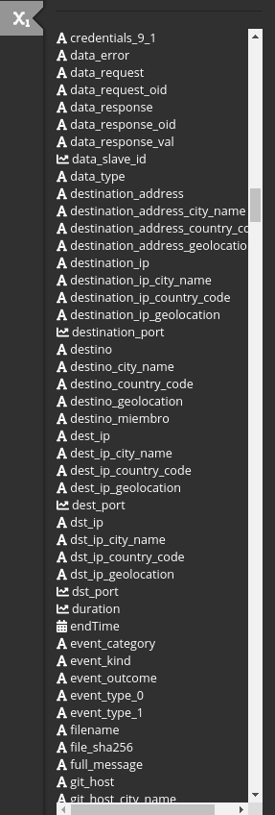
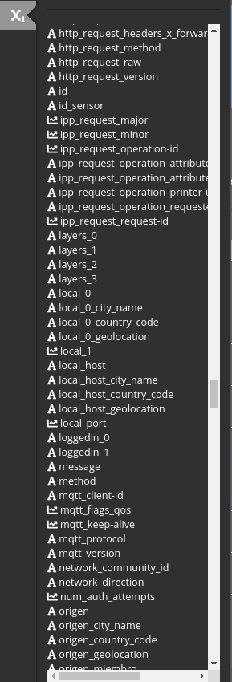
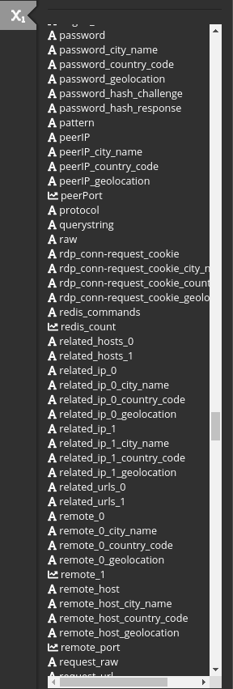
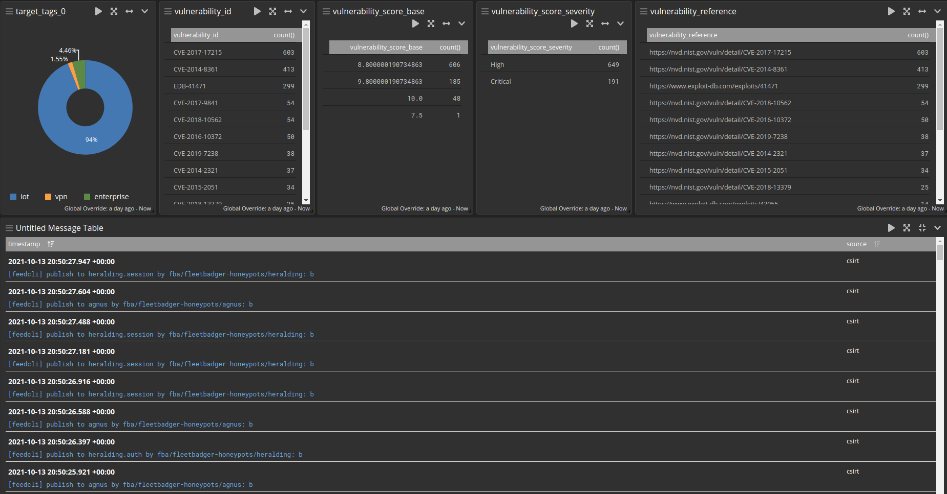
Generosa colección de datos (fields)

Slide 12
Sustainability
How to keep the project in a post-FRIDA founding era?
To keep promotion campaigns
To move to a voluntary schema
Look for funds/grants to implement new services
Dashboard
Alerts
Feeds?
Notes:
Now we are in a stage we are working on how to keep the project working and alive, trying to continue promoting the project, checking if changing to a voluntary (donation) schema will be manageable and/or look for funds to maintain the project and also improve or create new services like improving the dashboard, generating automatic alerts or providing a feed for the interested parties.

Slide 14
¡Gracias!
🕸 https://Sensores.LAT
📧 csirt@cedia.org.ec
📱 +593 99 924 6504 (Ernesto) +593 98 466 9053 (Paul)
¡Les esperamos en el proyecto!
Notes:
If you have any questions, this is the moment,
Oh, and also here you have a couple of phrases in Spanish for you to start learning a new language

